Slide 1

MOOCS PRESENTATION
SUBMITTED BY : DEEPANKAR SHARMA
BCA(GEHU -HALDWANI)

Slide 2
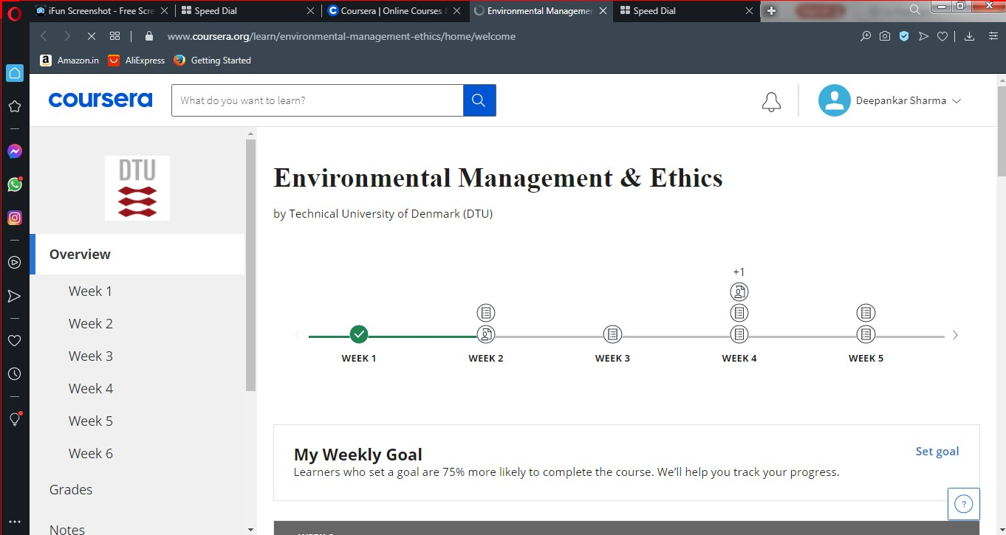
Technical University of Denmark (DTU)
Environmental Management And Ethics
DEEPANKAR SHARMA
STUDENT ID : 20041299
UNIVERSITY ROLL NO : 2092014

Slide 3

I would like to express my special thanks of gratitude to my teacher Mayurika Ma’am , who gave me The Golden Oopportunity to do this wonderful moocs seminar on the topic “ENVIRNMENTAL MANAGEMENT AND ETHICS”.
and also for providing with all the facilities that were required. The fact is I learnt a lot of new things during this course and I’ll surely implement the knowledge in my real like too.
REGARDS,
DEEPANKAR SHARMA

Slide 4







CONTENTS
WELCOME AND INTRODUCTION
ENVIRNMENTAL ETHICS
ENVIRNMENTAL MANAGEMENT OF WICKED PROBLEMS
DECISION-SUPPORT
TOOLS
ENVIRNMENTAL REGULATIONS AND PROBLEMS
RECOMMENDATION ON CHOOSEN ENVIRNMENTAL ETHICAL DIELEMMA

Slide 5



WELCOME AND INTRODUCTION
The environmental ethical dilemmas that we face a immense. In this module, we will introduce you to our course on Environmental Management & Ethics.

Slide 6
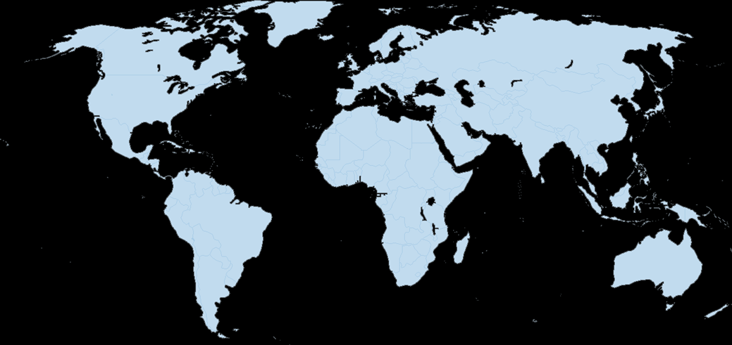
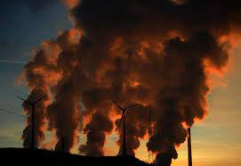
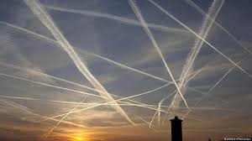
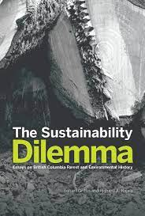
POLLUTION
TECHNOLOGY
SUSTAINABLITY

Slide 7

ENVIRNMENTAL ETHICS
In this module, we are introduced to environmental ethics in general and three different kinds of environmental ethics in specific.
Learning Objectives:
Describe
Define
Summarize
Give examples

Slide 8





LAND ETHICS
DEEP ECOLOGY
ECOFEMINISM

Slide 9




Environmental Management Of Wicked Problems
In the past, environmental problems were local and we could use our senses to detect them. We could see them, smell them and feel them and we could develop uniform solutions to them. They were tame problems. More and more of the environmental dilemmas and problems that we face are not tame. In this module, you will learn about environmental management of wicked problems in contrast to tame problems.

Slide 10
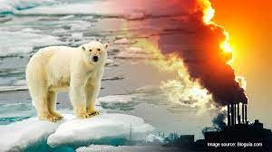
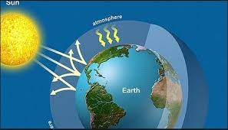
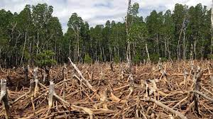

GREENHOUSE EFFECT
CONNECTED PROBLEMS
MELTING OF GLACIERS
DEFORESTATION
GLOBAL WARMING

Slide 11
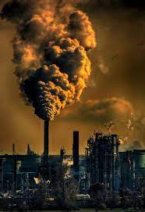
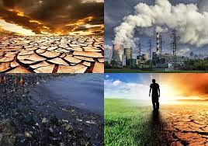

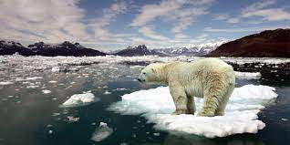

ENVIRNMENTAL PROBLEMS

Slide 12






Learning Objectives
EVALUATE
USE
PREPARE
COMPARE
SELECT

Slide 13

Decision-Support Tools
Tools and methods such as cost-benefit analysis, risk assessment, technology assessment often provide support to decision-maker when it making decisions about how to best management the environment and environmental resources. These decision-support tools have different ethical foundations and different set of values embedded in them, which are important to have in mind.

Slide 14
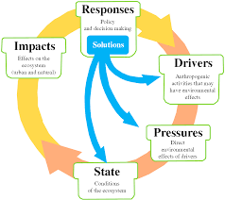

DPSIR
DPSIR (drivers, pressures, state, impact and response model of intervention) is a causal framework for describing the interactions between society and the environment: Human impact on the environment and vice versa because of the interdependence of the components.
COST BENEFIT ANALYSIS
A cost-benefit analysis (CBA) is the process used to measure the benefits of a decision or taking action minus the costs associated with taking that action.

Slide 15
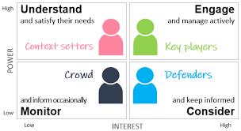

STAKEHOLDER ANALYSIS
Stakeholder analysis is a process of systematically gathering and analyzing qualitative infor- mation to determine whose interests should be taken into account when developing and/or implementing a policy or program.
TECHNOLOGY ASSESSMENT
Technology assessment is a scientific, interactive, and communicative process that aims to contribute to the formation of public and political opinion on societal aspects of science and technology.

Slide 16

Environmental Regulation And Principles
In this module, we were introduced to the main different kinds of implementing environmental regulation as well as some of the key environmental principles on which environmental management is based internationally.

Slide 17

Recommendations On Your Chosen Environmental Ethical Dilemma
In this module, we learned-by-doing how hard it can be to develop a set of clear recommendation to solve a given environmental ethical dilemma.

Slide 18
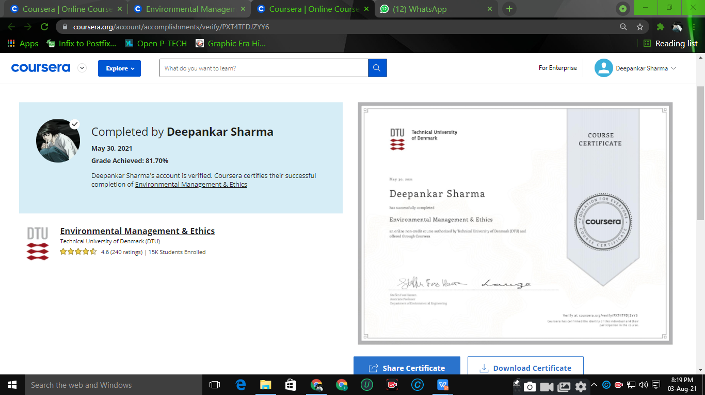
Certification click here to verify

Slide 19

THANKS

